Slide 1
A deformation order analysis tool for vehicle structures in crashworthiness design
Daniel Perez Ramirez
Massimo Sferza
Moustafa Alsayed Ahmad
Software Lab Presentation – 1st Review

Slide 2
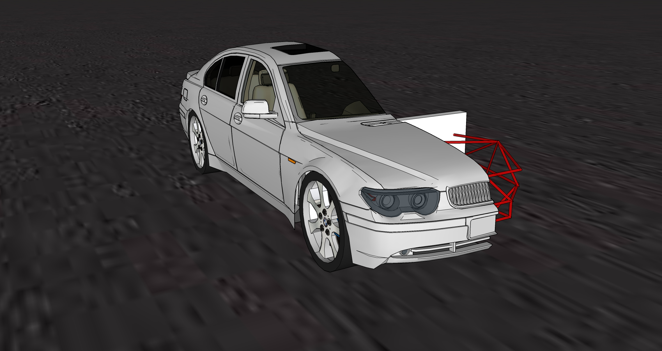
Early phase vehicle structure design
Notes:
CHANGE THIS IMAGE

Slide 3
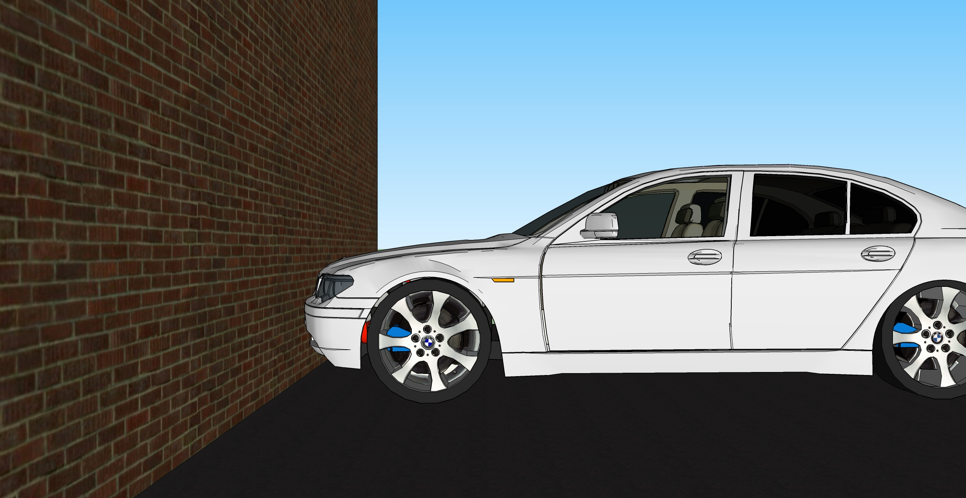
Front crash
Notes:
PIC WITH CRASH WALL, FIREWALL, ROD STRUCTURE OF THE CRASH BOX…

Slide 4
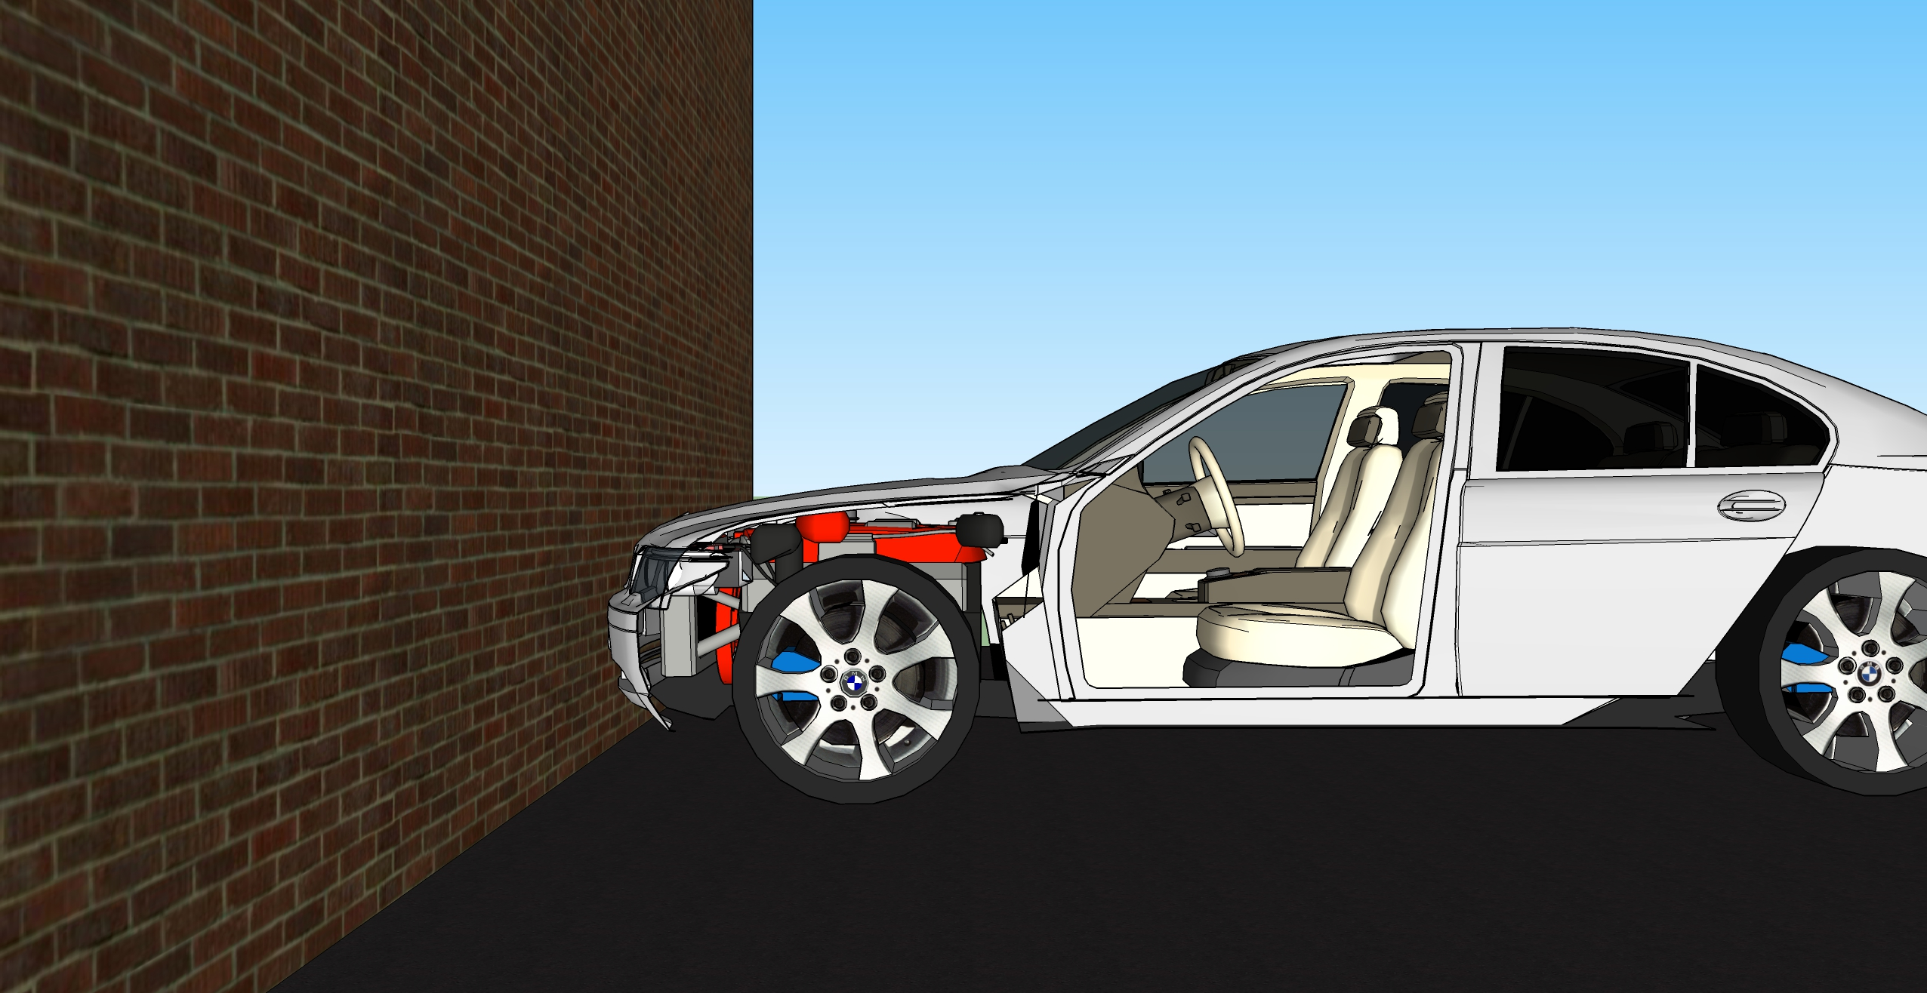
Front crash

Slide 5
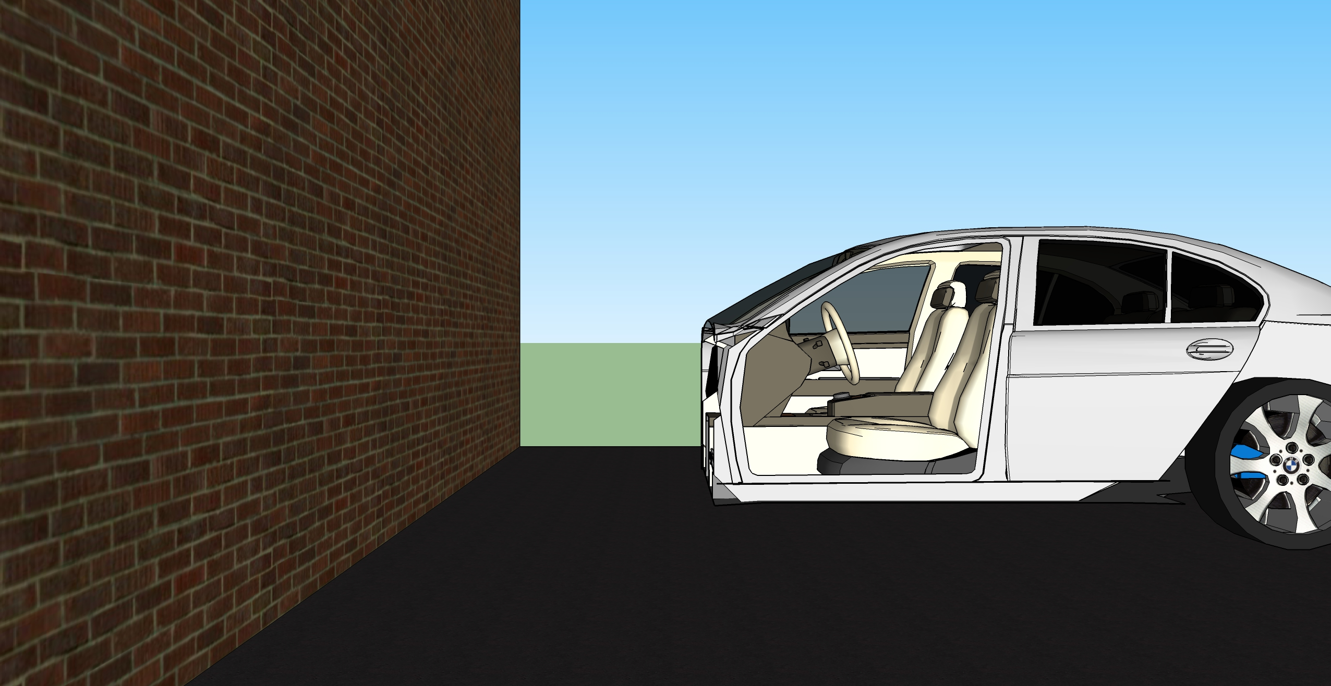
Front crash

Slide 6
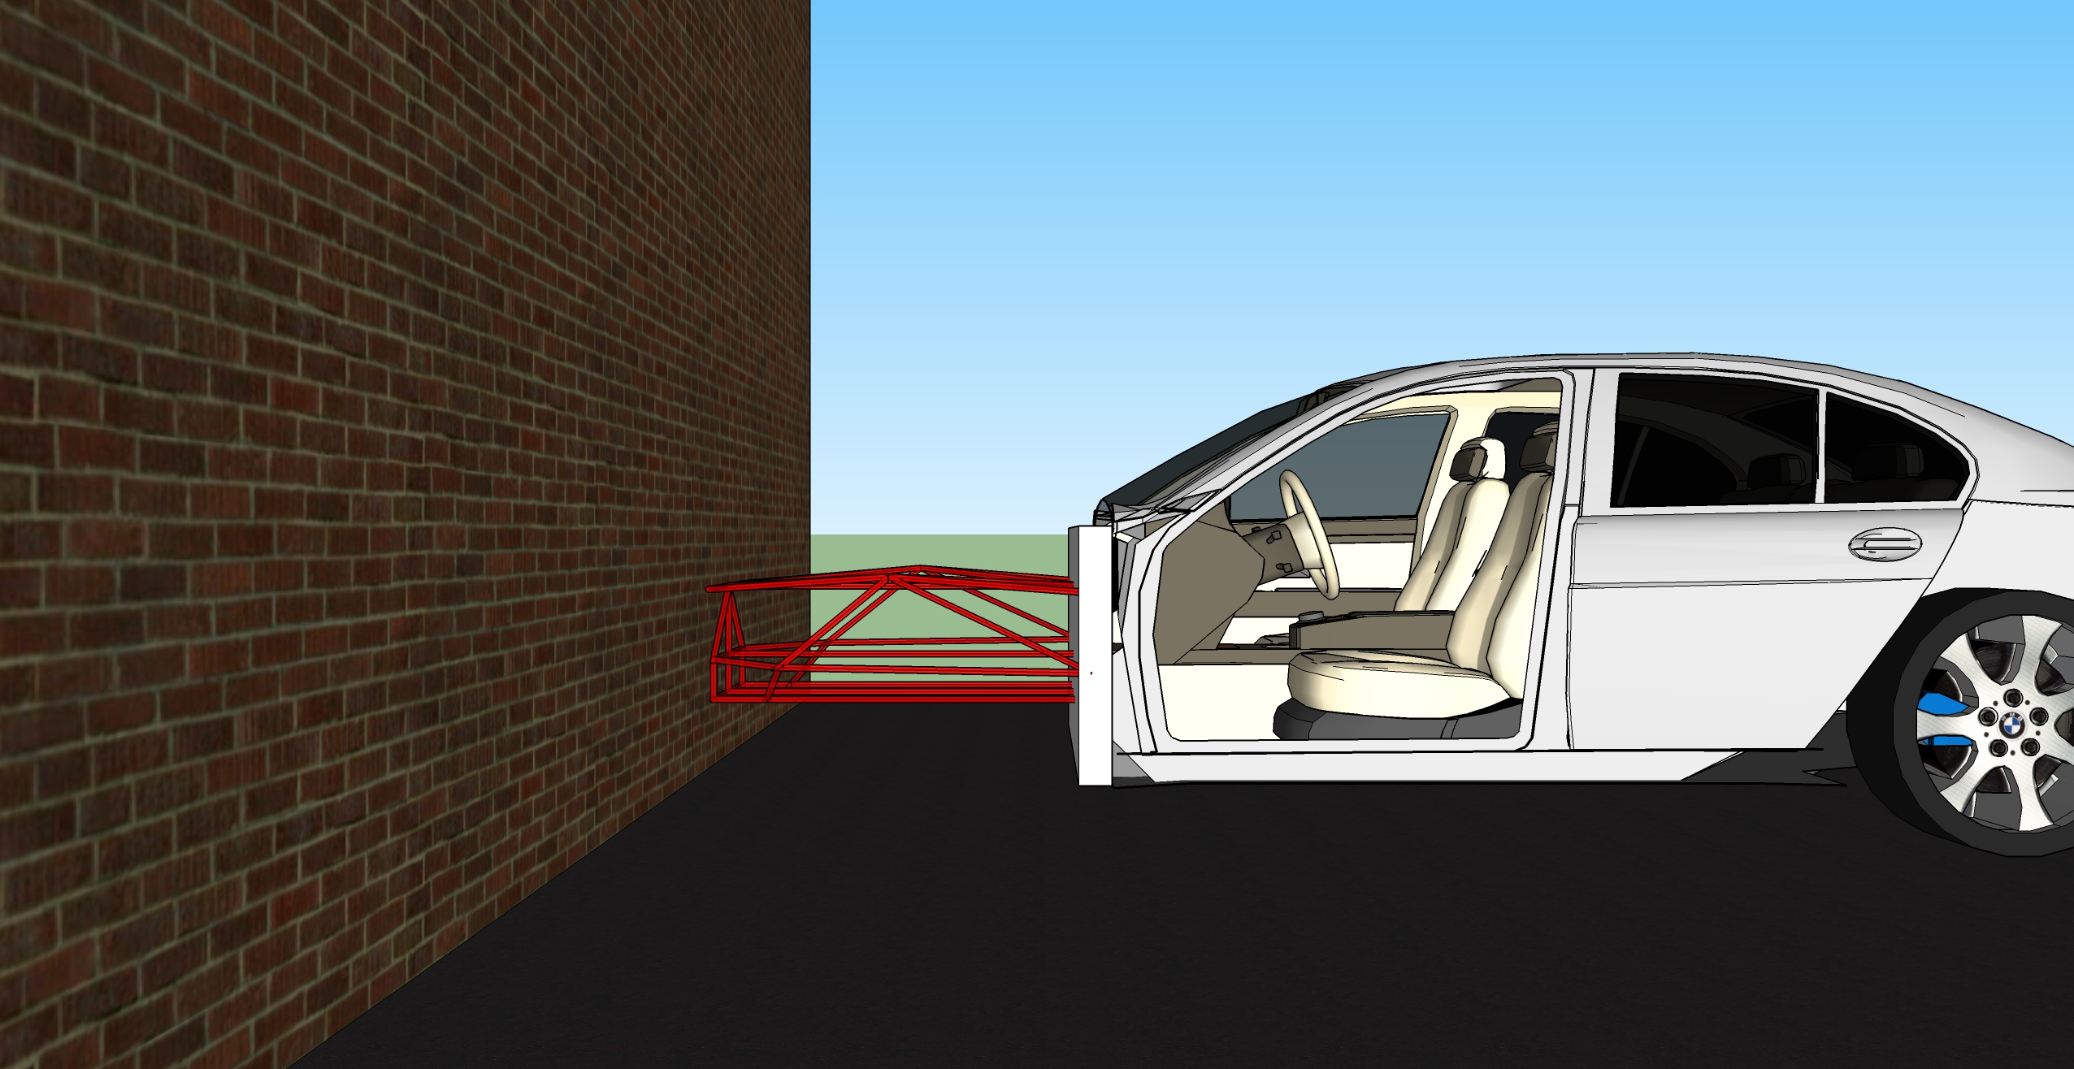
Front crash

Slide 7
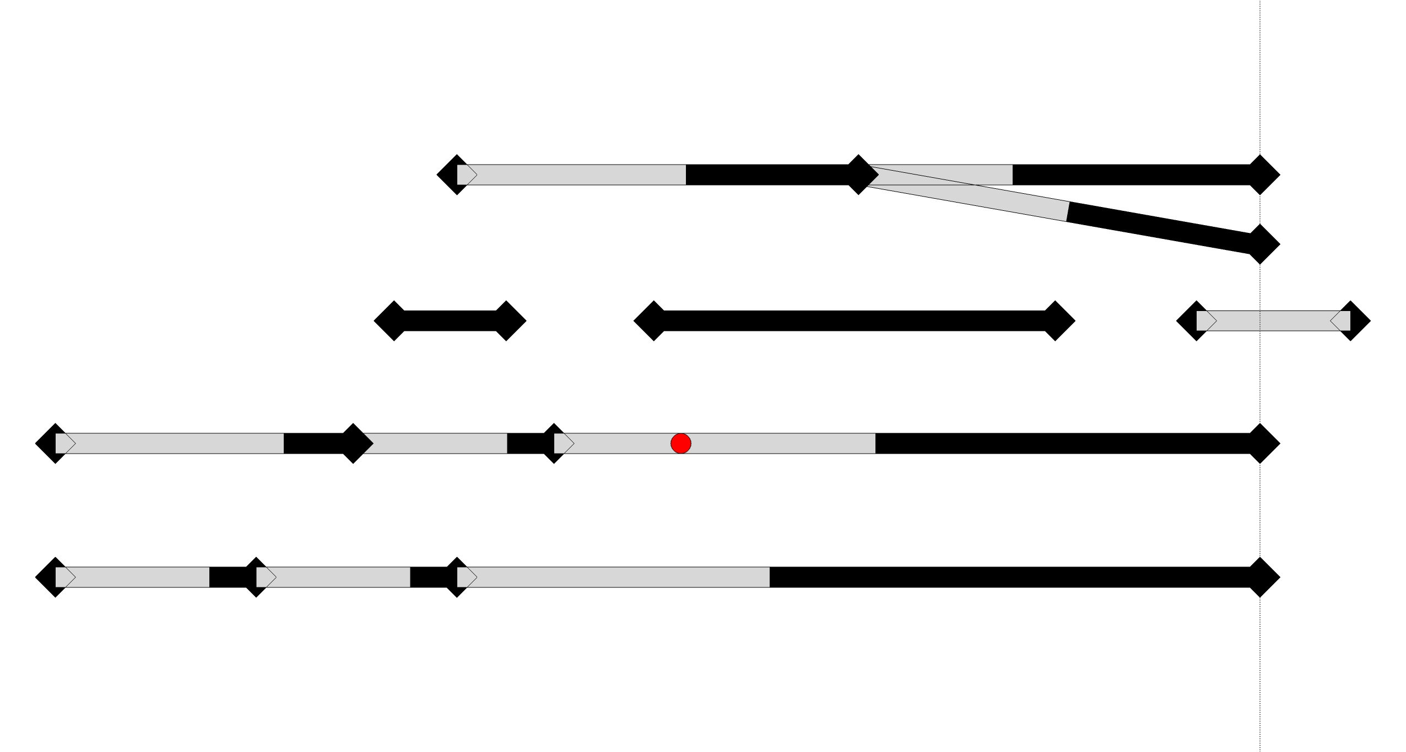
Order of deformation problem
Notes:
PIC OF A COMPLEX ORDER OF DEFORMATION PROBLEM

Slide 8
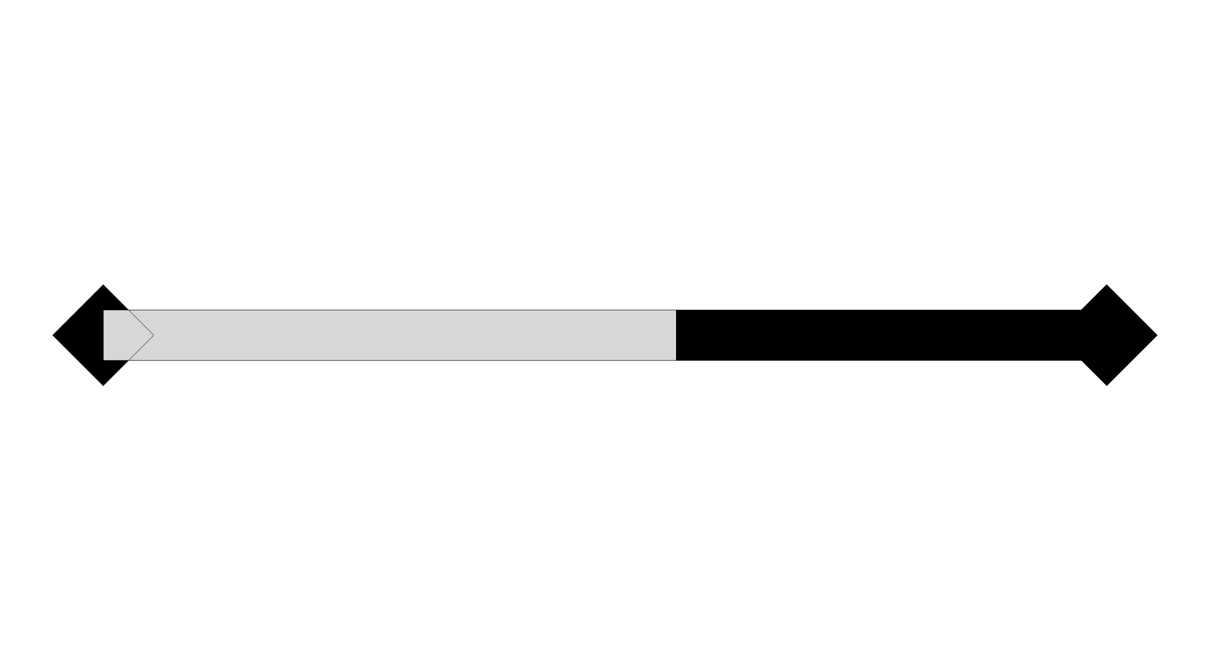
Order of deformation problem
Notes:
MEMBER WITH NODES

Slide 9
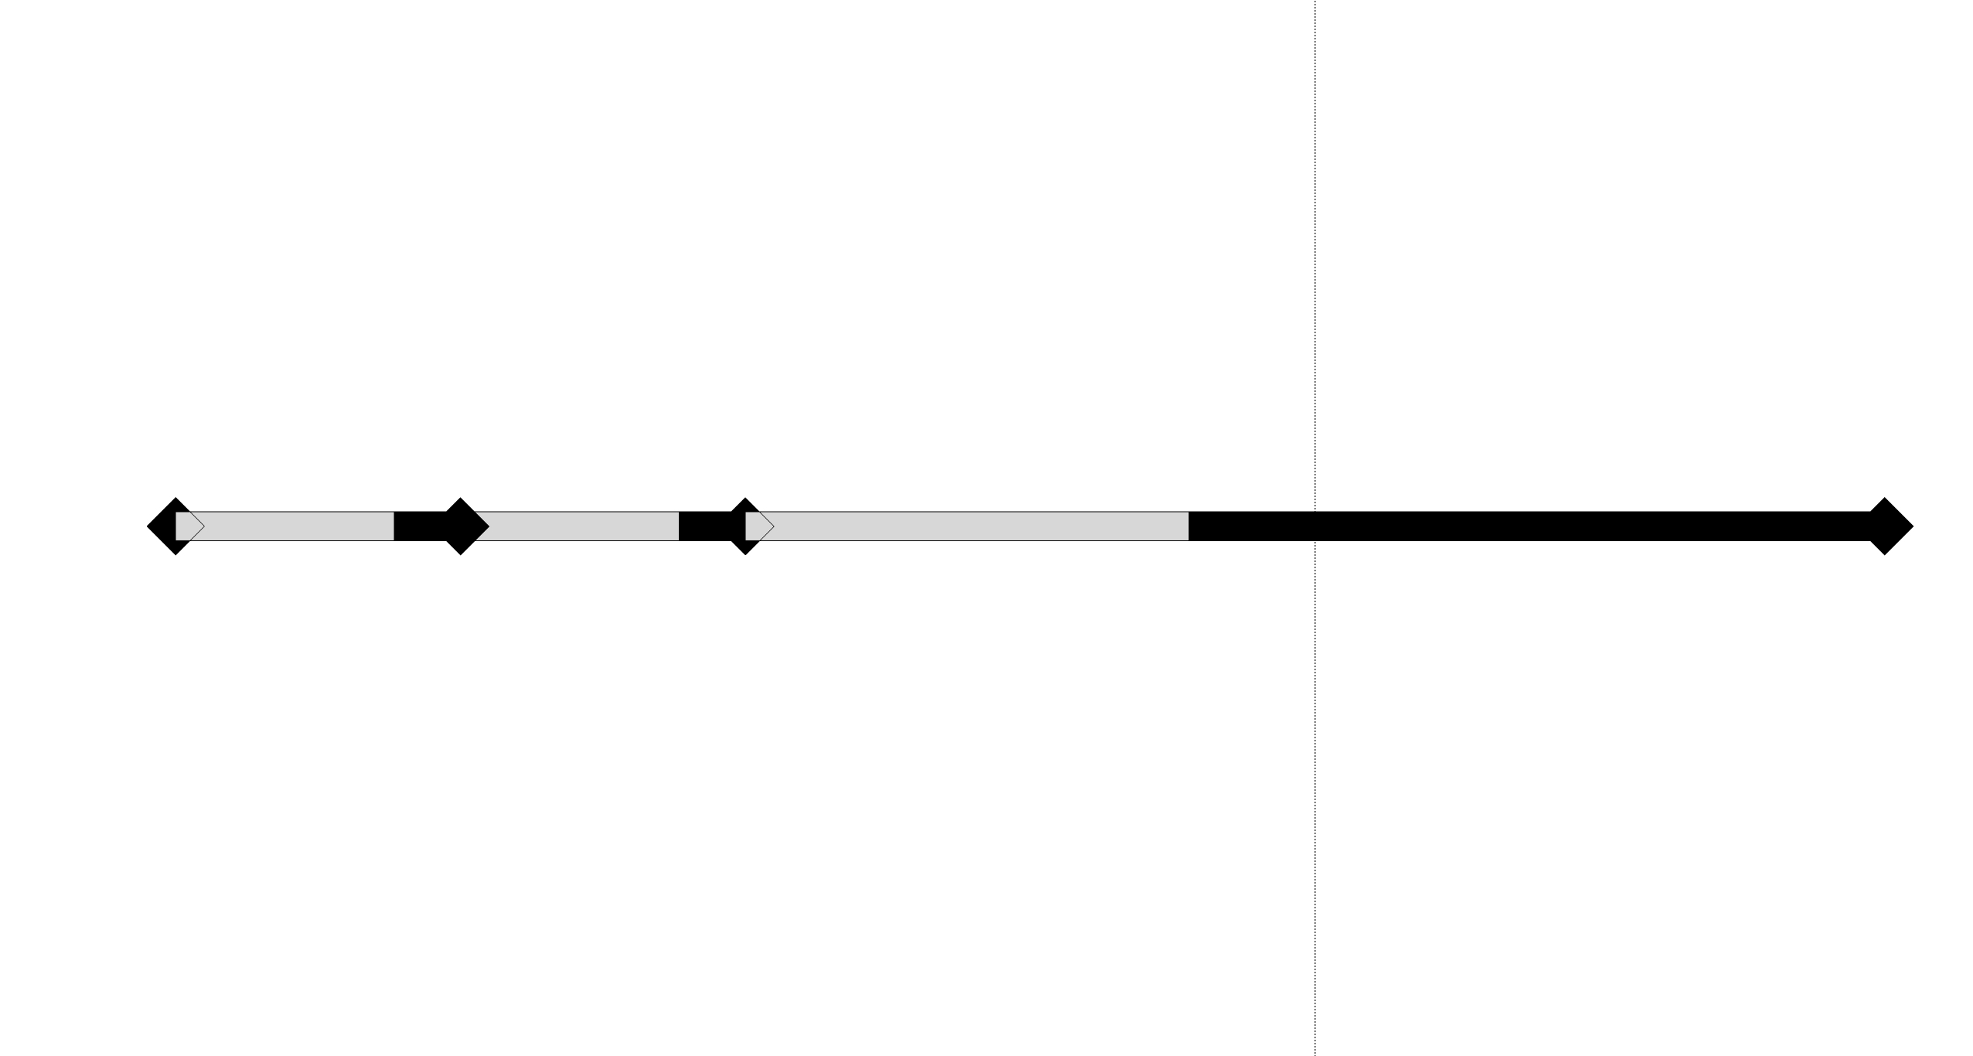
Order of deformation problem
Notes:
LOADPATH

Slide 10
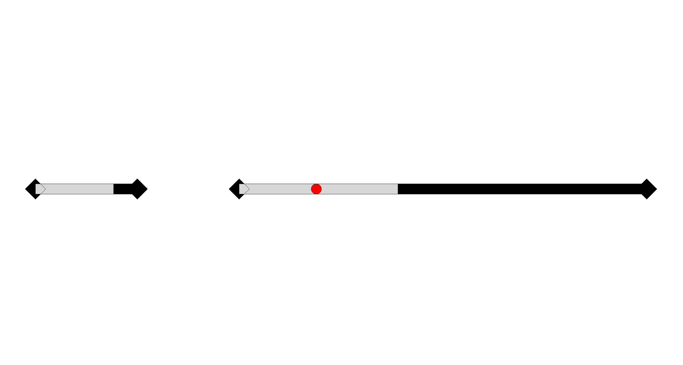
Order of deformation problem
Notes:
GENERAL LOADPATH with mass and gap

Slide 11
Order of deformation problem
Notes:
CRASHBOX

Slide 12
Ood problem: example 1
Notes:
1° example

Slide 13
Ood problem: example 2
Notes:
2° example

Slide 14
Ood problem: complex case
Notes:
General problem

Slide 15

Engineers are still doing that using paper and a pen
Notes:
frustration

Slide 16
Tasks of our project
Given a topological structure, solve the OoD problem
Given the material properties, find the actual OoD
Show the results in a graphical animation video

